Slide 1

PERCENTAGES

Slide 2
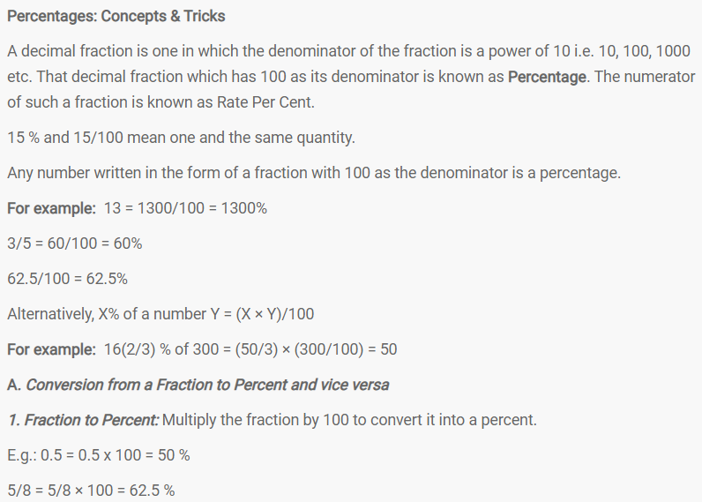

Slide 3
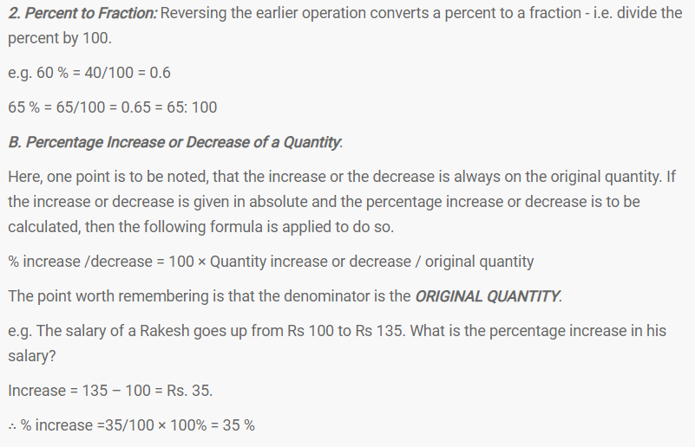

Slide 4
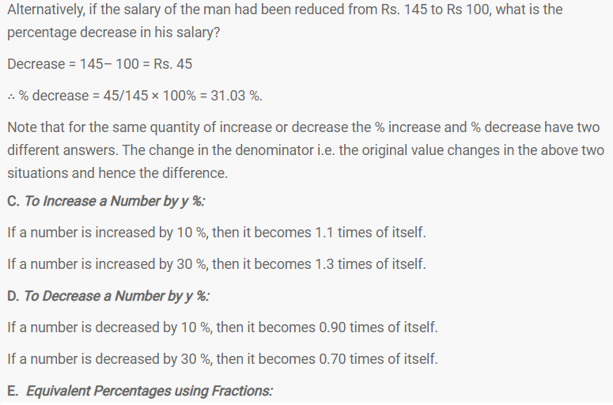

Slide 5
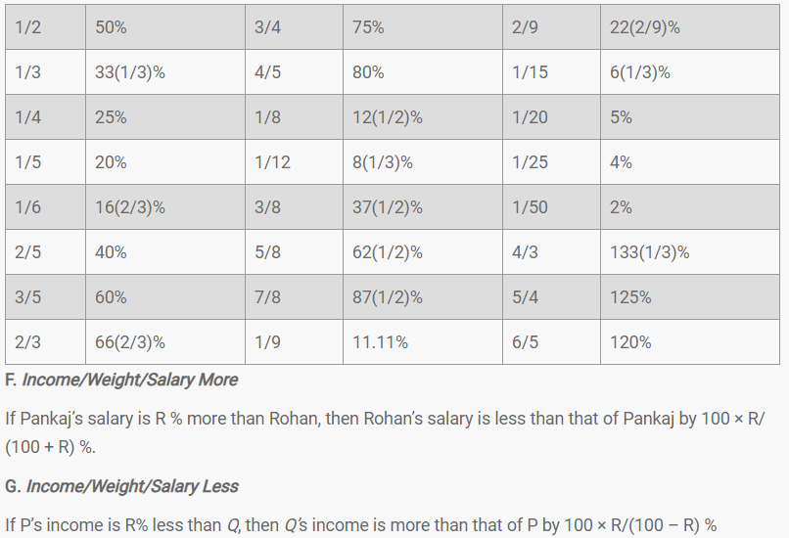

Slide 6
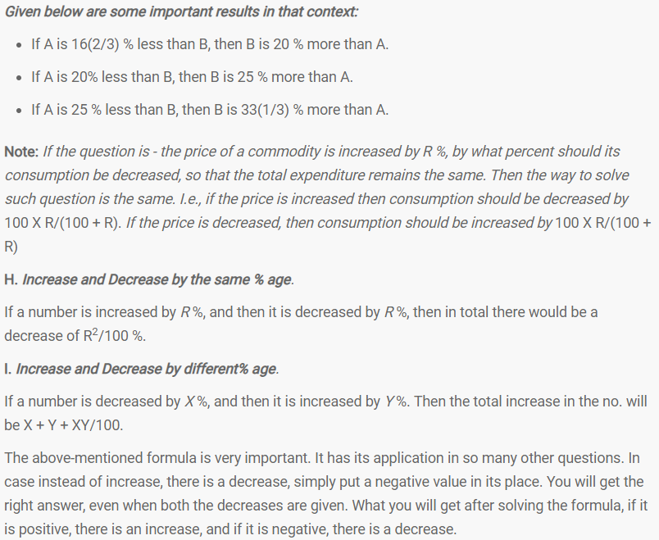

Slide 7

Question No. – 1

Slide 8

Answer

Slide 9

Question No. – 2

Slide 10

Answer

Slide 11

Question No. – 3

Slide 12

Answer

Slide 13

Question No. – 4

Slide 14

Answer

Slide 15

Question No. – 5

Slide 16

Answer

Slide 17

Question No. – 6

Slide 18

Answer

Slide 19

Question No. – 7

Slide 20

Answer

Slide 21
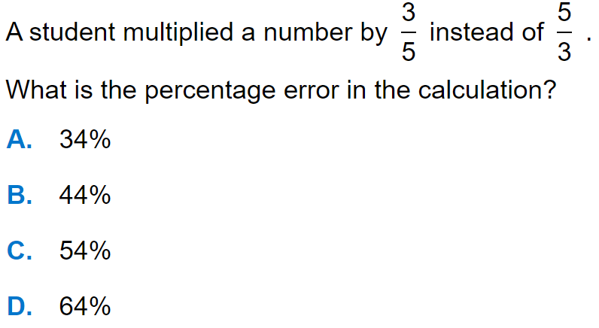
Question No. – 8

Slide 22
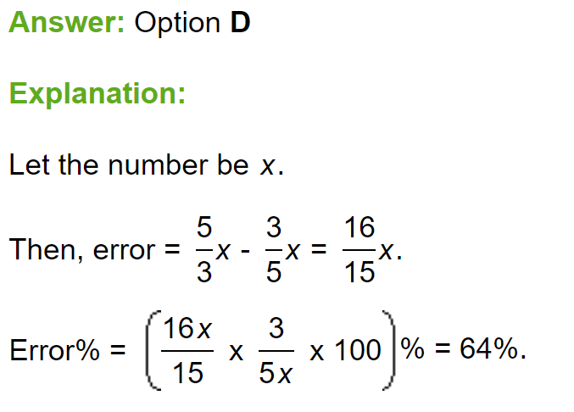
Answer

Slide 23

Question No. – 9

Slide 24
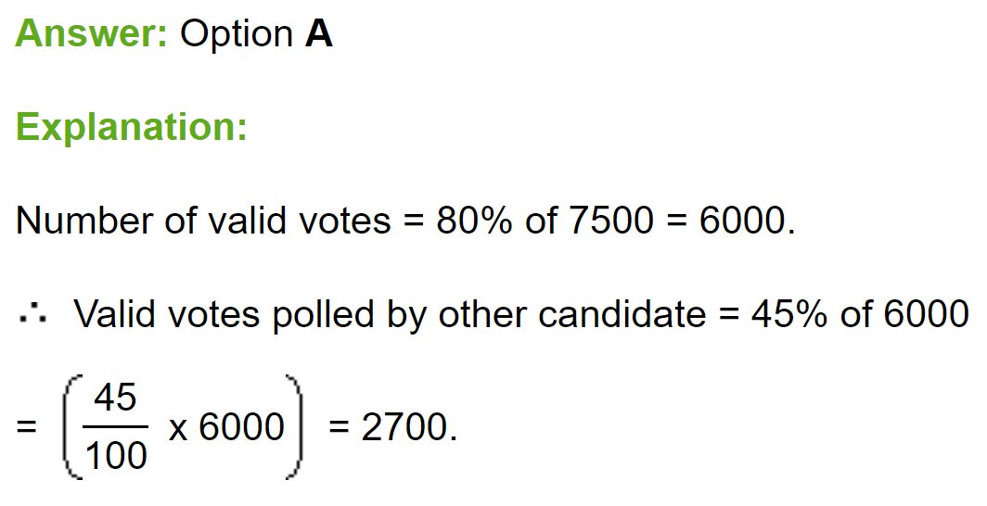
Answer

Slide 25
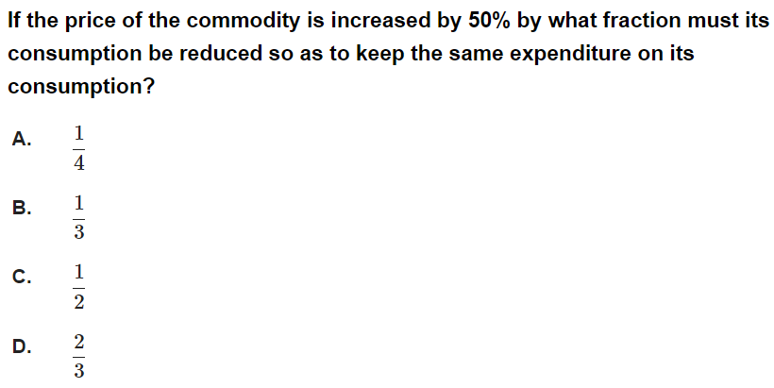
Question No. – 10

Slide 26
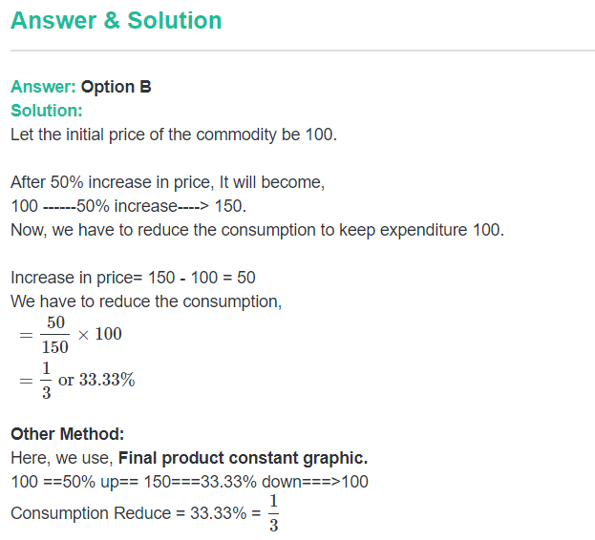
Answer

Slide 27
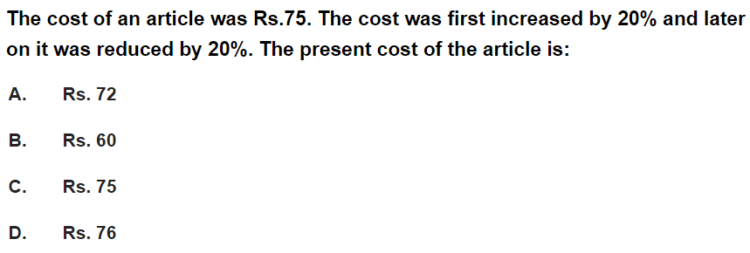
Question No. – 11

Slide 28
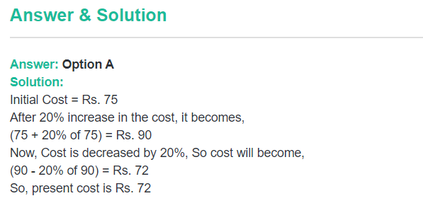
Answer

Slide 29
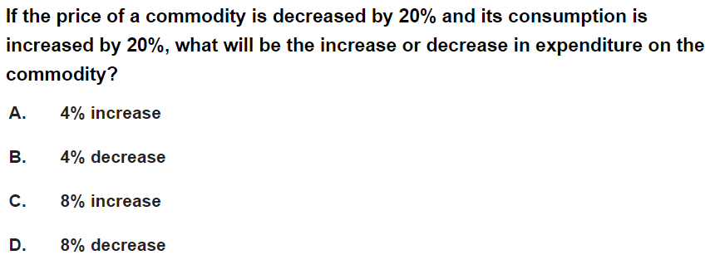
Question No. – 12

Slide 30
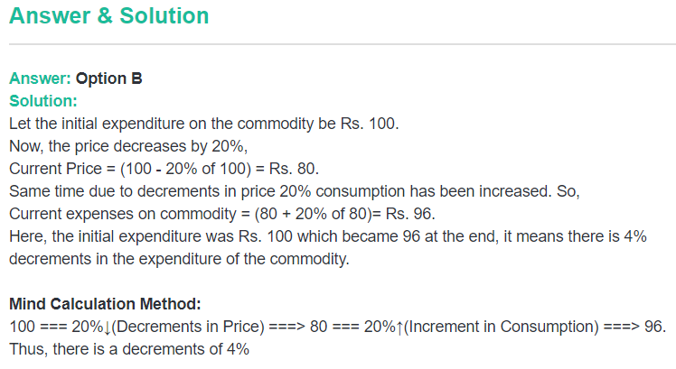
Answer

Slide 31
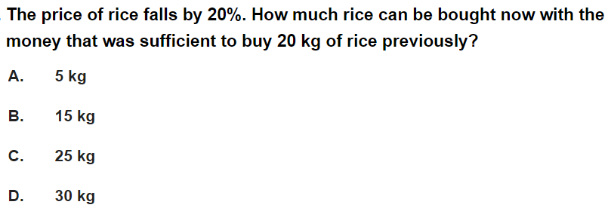
Question No. – 13

Slide 32
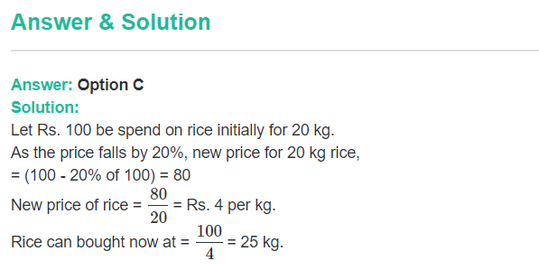
Answer

Slide 33
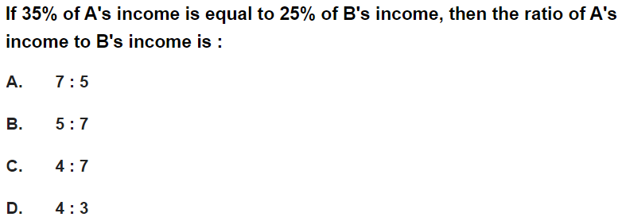
Question No. – 14

Slide 34
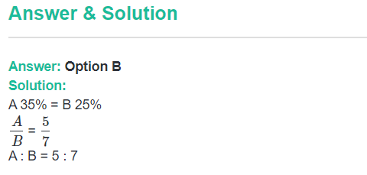
Answer

Slide 35
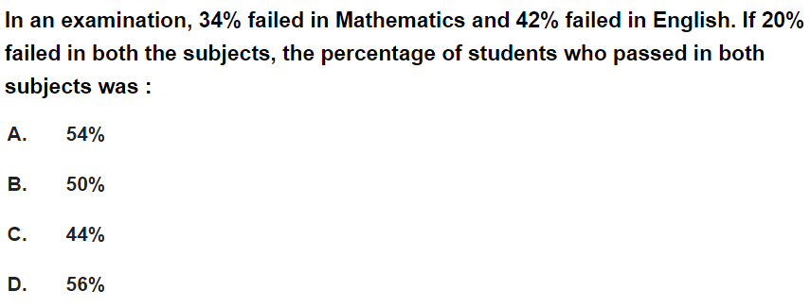
Question No. – 15

Slide 36
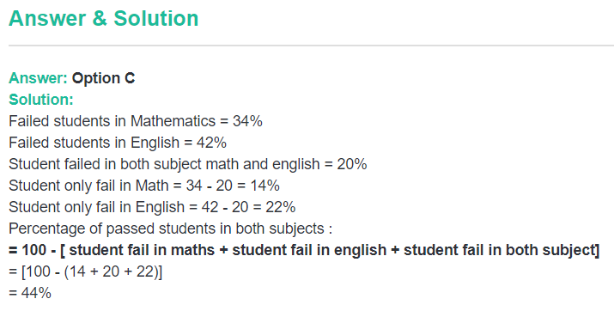
Answer

Slide 37
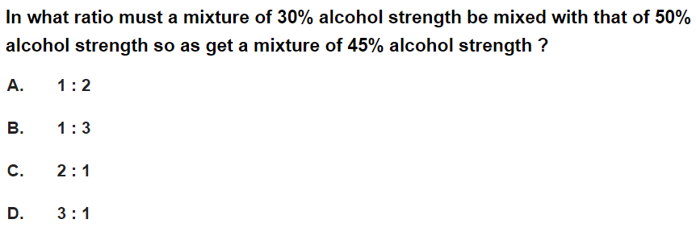
Question No. – 16

Slide 38
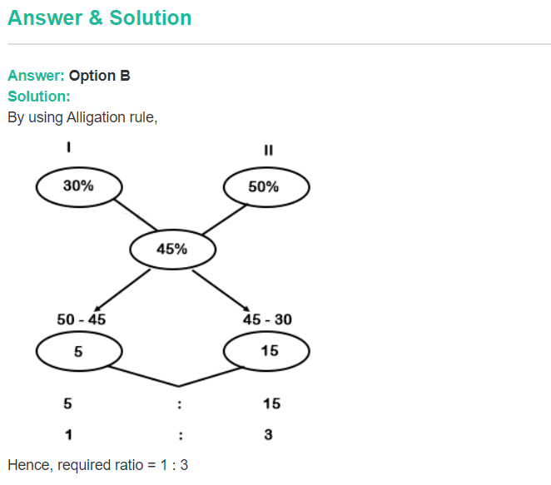
Answer

Slide 39
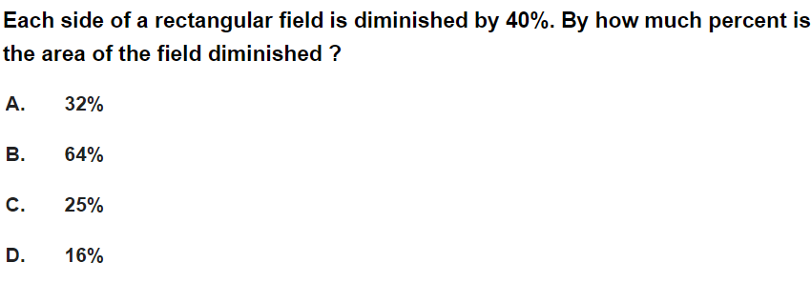
Question No. – 17

Slide 40
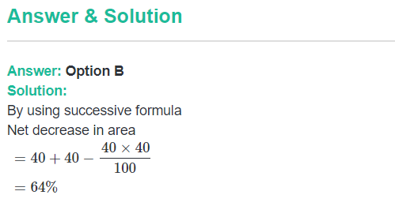
Answer

Slide 41
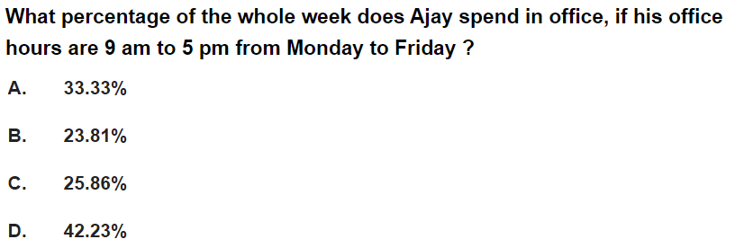
Question No. – 18

Slide 42
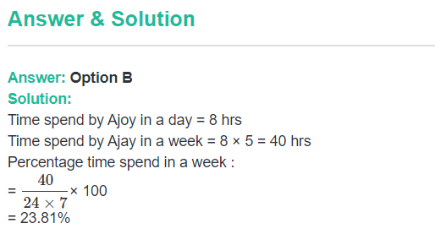
Answer

Slide 43
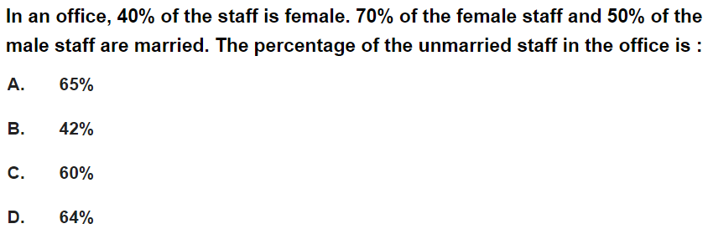
Question No. – 19

Slide 44
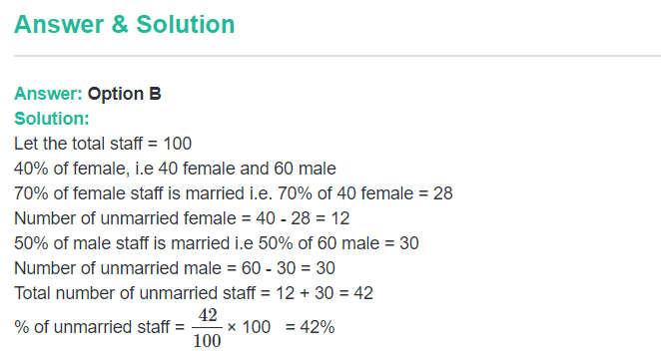
Answer

Slide 45
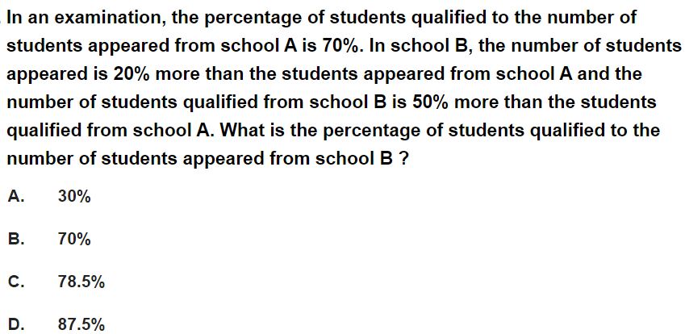
Question No. – 20

Slide 46
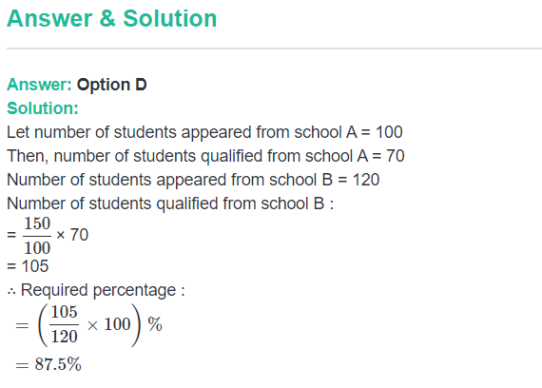
Answer

Slide 47
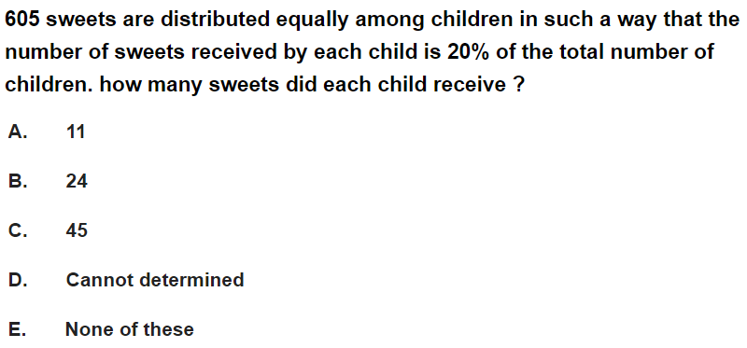
Question No. – 21

Slide 48
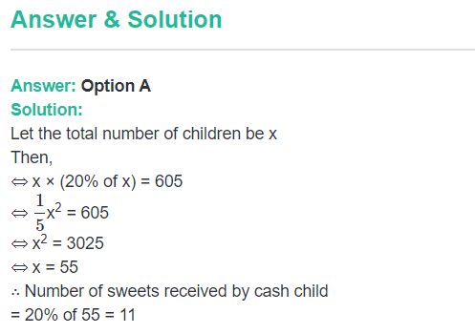
Answer

